Slide 1
Event Agenda
What is Git, GitHub?
What is VCS?
Types Of Version Controlling Systems
Centralized Version Controlling Systems
Q & A***

Slide 2

What is ?
Notes:
So what would you do with it? We are here to help you answer that question
Lets start with a brief introduction about Technobuzz.
It’s a workshop series to help you shape your career and decide a career path. It will also help you understand how technology can help your business.
We will first cover an introduction to a field of technology which is for today, Cloud Computing, and discuss career opportunities available in the field and we’ll provide you with the learning resources for you to move forward after this session. We will have a hands-on session tomorrow for more concrete understanding of what you learn today.
Enough of Technobuzz, now lets dive into cloud computing

Slide 3
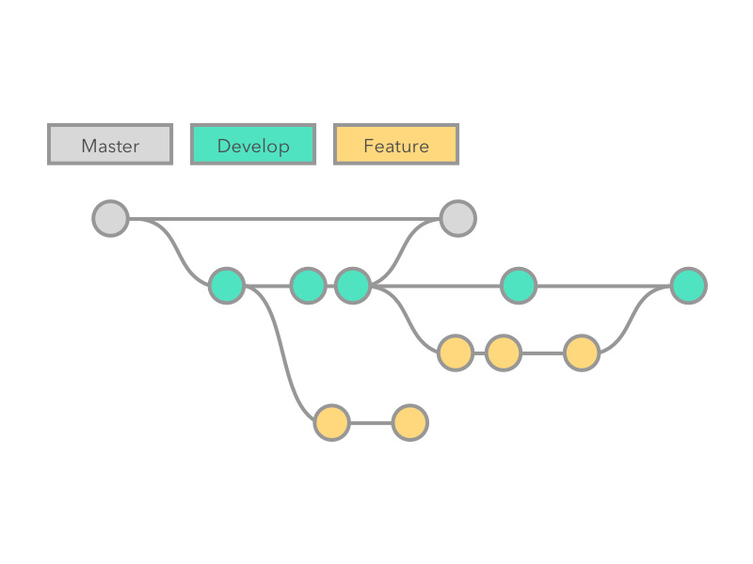
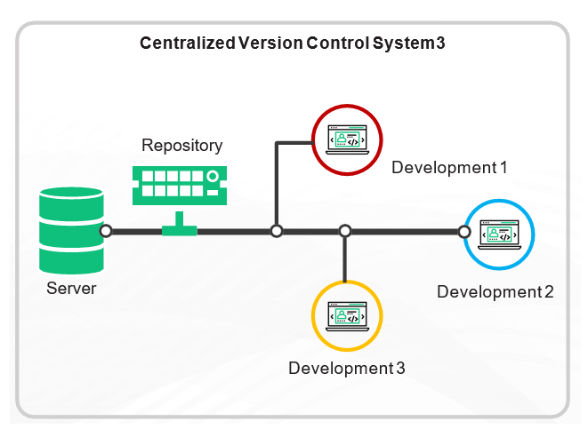

What is Version Control?
A version control system allows users to keep track of the changes in software development projects and enable them to collaborate on those projects. Using it, the developers can work together on code and separate their tasks through branches.
Examples : GIT, CVS, SVN, Bitkeeper etc.

Slide 4

Types Of Version Controlling Systems
Local Version Controlling
Centralized Version Controlling
Distributed Version Controlling

Slide 5
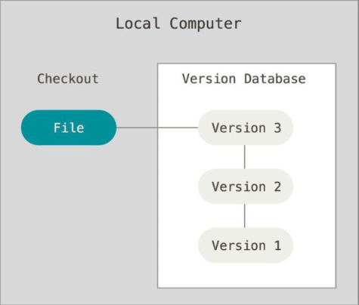
Local Version Controlling Systems

Slide 6
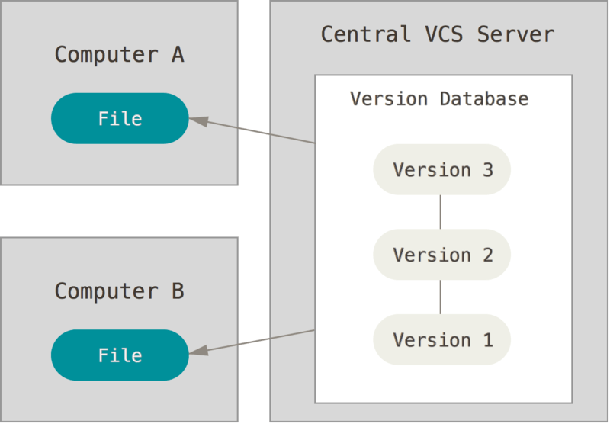
Centralized Version Control System

Slide 7
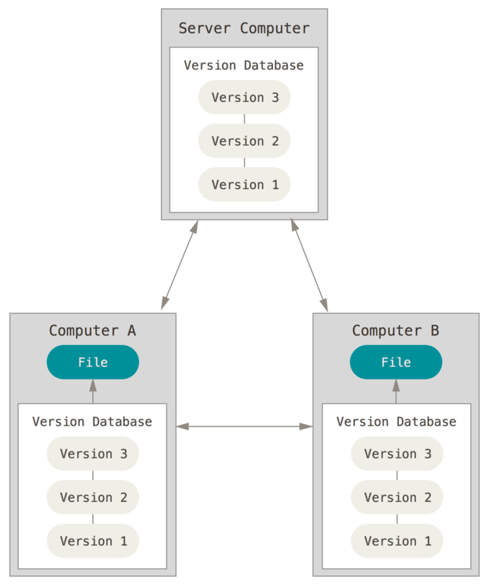
Distributed Version Control System

Slide 8
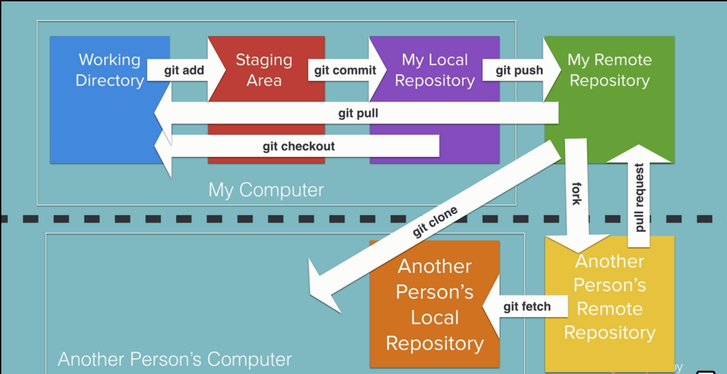
Git Workflow

Slide 9

Git Branch

Slide 10
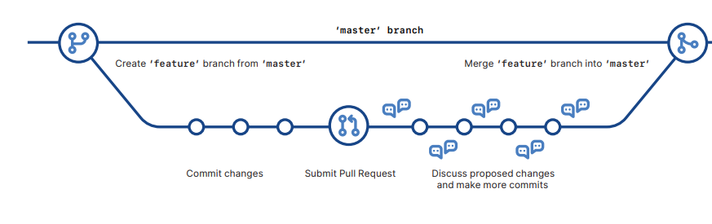
Github Workflow

Slide 11
Contributor vs Collaborator
Contributor: A contributor is someone from the outside not on the core development team of the project that wants to contribute some changes to a project.
*** Collaborator: A collaborator is someone on the core development team of the project and has commit access to the main repository of the project.

Slide 12
What’s Next?
Do some Hands-On

Slide 13
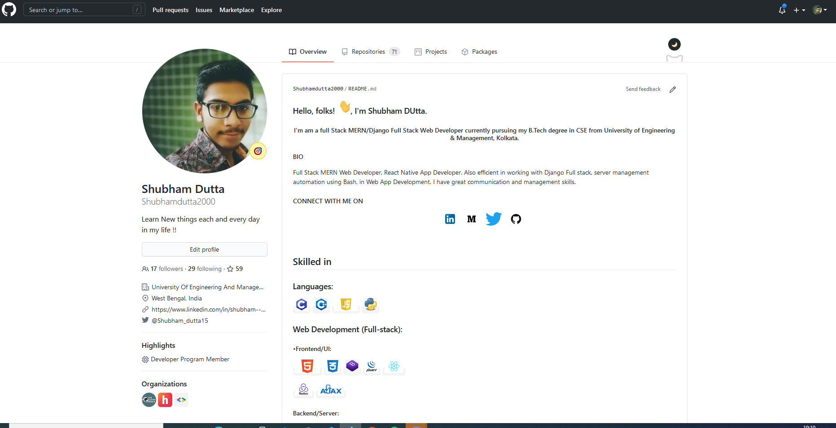
Go to Github.com

Slide 14
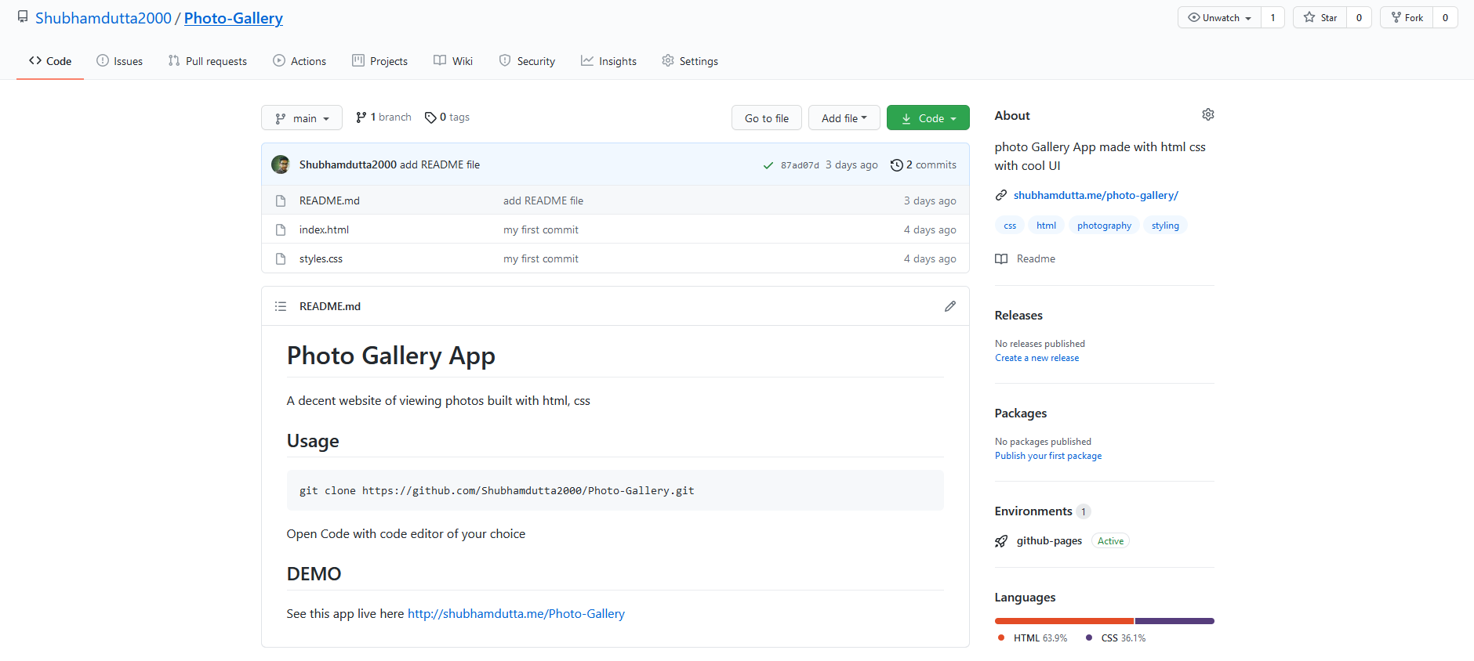
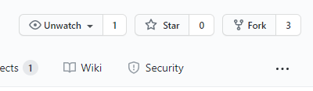
Fork in Github

Slide 15
Got the Codes in your account?
Notes:
Let’s hear it from you guys first. What do you think is cloud computing?

Slide 16
Want to be
a Collaborator?

Slide 17
Congratulations ☺
You’re a Collaborator
Now

Slide 18
Let’s Create a website using Html, CSS, JS & Bootstrap & Deploy it *_*

Slide 19
Queries ?

